Slide 1


Growth of AI
Ethics in AI & Risk categories
“AI will probably most likely lead to the end of the world, but in the meantime, there'll be great companies.” - Sam Altman.
1
2
Unacceptable Risk
3
EU’s AI Act will ban AI-systems.
Law Enforcement.
High-Risk
EU categorizes high-risk AI-systems in two main groups.
First group is EU-regulated products.
Second group is specific areas.
Generative AI
4
EU also has strict measures for generative AI Models.
When is content AI-generated.
Prevent from generating illegal content.
Copyrighted data.
Limited Risk
Basic transparency.
Inform the users.

Slide 2
Ethics in AI & Risk categories
1
2
3
4
Unacceptable Risk
High-Risk
Generative AI
Limited Risk
EU’s AI Act will ban AI-systems.
Law Enforcement.
EU categorizes high-risk AI-systems in two main groups.
First group is EU-regulated products.
Second group is specific areas.
EU also has strict measures for generative AI Models.
When is content AI-generated.
Prevent from generating illegal content.
Copyrighted data.
Basic transparency.
Inform the users.
Notes:
Unacceptable Risk:
The EU’s AI Act will ban AI-systems considered unacceptable risk such as those that manipulate behaviour or categorize individuals based on personal traits.
Law enforcement, though, may use real-time biometric identification like facial recognition, but only under strict conditions and in serious cases, which ensures a balance between technological advancement and ethical standards.
High Risk: The EU categorizes high-risk AI-systems into two main groups:
AI-systems used in EU-regulated products like toys, aviation, cards, medical devices and so on.
AI-systems that fall into specific areas that will have to be registered in an EU database like management of critical infrastructure, education, law enforcement, migration management and so on.
Generative AI:
The EU also has strict measures for generative AI Models such as CHATGPT:
Clearly disclosing when content is AI-generated.
Designing the model to prevent it from generating illegal content.
Publicly summarizing copyrighted data used for training.
Limited Risk: - AI-systems can have limited risks, which require basic transparency so users are informed and can decide themselves whether they want to continue using them or not.

Slide 3

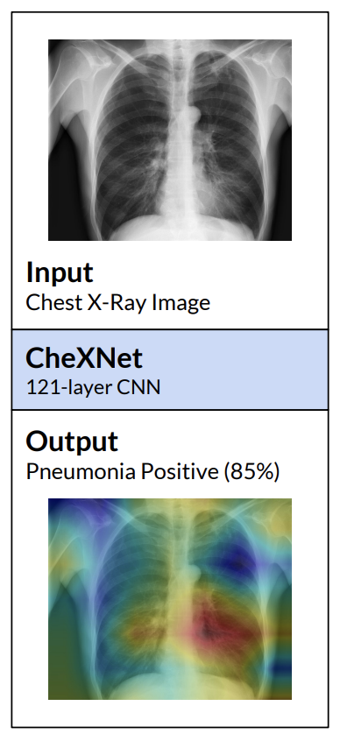

Current AI utilization in business
Support tool rather than replacement
Internet and data research
Machine learning
Cybersecurity
Customer support

Slide 4
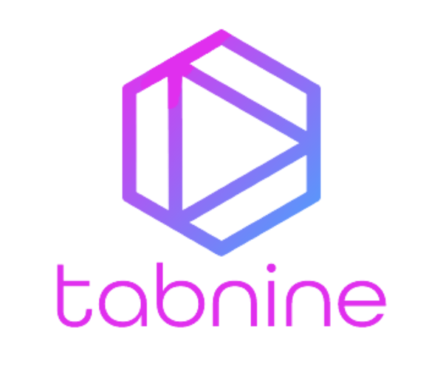

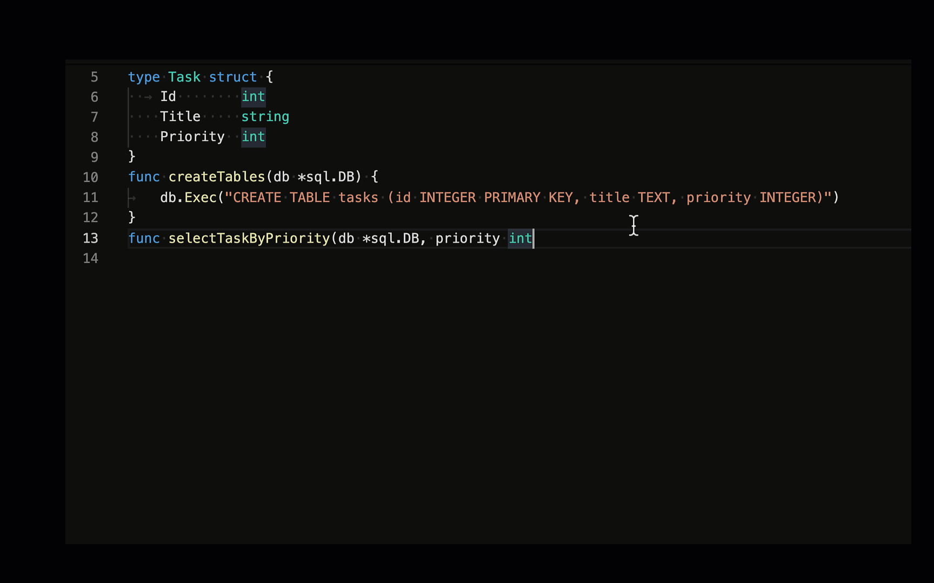
Innovative AI products in IT
AI in code editors: CoPilot, CodeWhispere, Tabnine, Jetbrains AI, Phind, Cursor
Code completion
Chatting with your codebase
AI writing tests
Debugging
Generating commit messages
good at boilerplate

Slide 5

Personal insights on AI's future impact
job automation/risk: job displacement
raise concerns about privacy and bias
natural language user interfaces. for example: coding in natural language

Slide 6

Conclusion

